Slide 1
Term 4 Week 2 Answers
Maths Tasks

Slide 2
Monday
BLUE | RED | GREEN
Write the following questions out in an algorithm and calculate the answers. a)1964 + 5282 = 7246 b)4715 + 4563 = 9278 c)7695 + 2178 = 9873 d)9238 + 4768 = 14006 | Write the following questions out in an algorithm and calculate the answers. a)21964 + 35282 = 57246 b)34715 + 94563 = 129278 c)67695 + 22178 = 89873 d)19238 + 34768 = 54006 | Find the missing numbers: a) 5 + 91 + 5623 + 911 = 6630 b) 38 + 58 + 8798 + 649 = 9543 c) 671 + 1297 + 26 + 17 = 2011 d) 849 + 9558 + 62 + 97 = 10566
If an ice block cost $1.50 each, how much would it cost to buy 3 of them? $4.50 If a can of Sprite cost $2 each, how much would it cost to buy 5 of them? $10 | Merlin trained 82,016 dragons, Miss Peters trained 399 dragons and Mrs Durose trained 31,427 dragons. What is the difference in the amount of dragons trained by Miss Peters and Mrs Durose? 31028 | John sold 318 oranges, 257 apples, 198 pineapples and 1450 bananas. a)How many items of fruit did John sell? 2223 b)If he sold each item of fruit for 50c and the pineapples for double that price, how much money did he make? $1012.50 + $1450 = $2462.50
On Monday Abby sold 94 mice, 67 puppies, 483 goldfish and 159 birds. a)How many pets did Abby sell? 803 b)If Abby sold double the amount as Monday on Tuesday. How many animals did she sell on Tuesday? 1606 c)Wednesday, Thursday and Friday she sold the same amount of animals as Monday. How many animals did she sell throughout the week? 4818 | Complete the follow questions and use the inverse operations to check your answers. a)Jeremy saved 916 pens and was given 1275 by his Grandfather. How many does he have now? 2191 b)Jet’s book has 608 pages. He has read 239. how many more does he have to read? 369 c)On a farm there were 3702 sheep. Jill sold 395 to jack who already owned 1454. How many does Jill have now? How many does Jack have now? | Write the following questions out in an algorithm and calculate the answers. a)67283 + 3428173 = 3495456 b)836524 + 46725 = 883249 c)462834 + 82634 = 545468 d)936724 + 73542 = 1010266 e)472090 + 73500 = 545590
Jim purchased a new car for $45,000, new tires for $5000, seat covers for $200 and floor mats for $50. How much did he spend all together? $50,250 | Miss Davis needs to provide enough orange juice for all of the students in her class for their end of year party. If each student is going to be provided with 230 ml of juice and Miss Davis bought 5.5 litres, how many students are in her class? There are 23 students in Miss Davis’ class | Two packs of 6 ($7.70). 4 packs $8.07 or individually $9. $2.07 25c

Slide 3
Tuesday
BLUE | RED | GREEN
Write the following questions out in an algorithm and calculate the answers. a)5639 - 3728 = 1911 b)8925 – 3927 = 4998 c)7294 – 2837 = 4457 d)2729 – 1002 = 1727 | Write the following questions out in an algorithm and calculate the answers. a)98735 – 28153 = 70582 b)82534 – 37463 = 45071 c)84632 – 48373 = 36259 d)39384 - 28476 = 10908 | Fill in the missing numbers: a) 90163 - 3258 = 86905 b) 74866 - 8486 = 66380 c) 94189 - 1859 = 92330 d) 62976- 9298 = 53678
Fil in the missing numbers: a) 9016 - 150 = 8866 b) 7000 - 1500 = 5500 c) 5500 - 990 = 4510 d) 905 - 450 = 455 | Merlin was selling 63,004 dragon spikes a month, and 3,265 dragon teeth. After a year, the sales of dragon spikes decreased by 7,567. How many spikes does he sell a month now? 55437 | Write the following questions in algorithms and answer them. a) 852132 – 714011 = 138121 b) 416581 – 132623 = 283958 c) 255921 – 120614 = 135307 d)524132 – 231310 = 292822
There are 237 people on the train when it leaves Central Station. When it gets to Town Hall, 75 people get off and 102 people get on. How many people are on the train as it departs Town Hall station? 237 - 75 = 162 162 - 102 = 264 people | Your school bought 15 packets of 80 pencils with a budget of $480. How much did each pencil cost if the school went over budget by $150? The pencils cost $0.53 each. | Dale’s house renovations fell under budget! If he went 18% under his original budget of $156 000, how much did he actually spend on his renovations? 18% = $28,080 156, 000 - 28,080 = $127, 920
Stephanie had $150 to spend at the shops, she spent $18 on food, $60 on a new pair of shoes, $12 on a smoothie and $40 on a new school bag. How much money did she have left? $20 | The local tennis club needed new tennis balls. To pay for all the new balls, each person in the club donated $12.45. The bill for the new balls came to a total of $510. The club had $50.25 left over and decided to put it towards their end of year Christmas party. How many people are members at the tennis club? There are 45 members at the tennis club. | Jack is buying a new couch. He has found a couch that he loves at 3 different stores. Its full price is $1460, but the first store had it one sale for 15% off, the second store had it on sale for 1/5 off the original price and the third store has it on sale for 0.21 off the original price. Which store should he buy the couch from and how much will pay? Jack should buy the couch from the third store as he will only pay $1153.40.

Slide 4
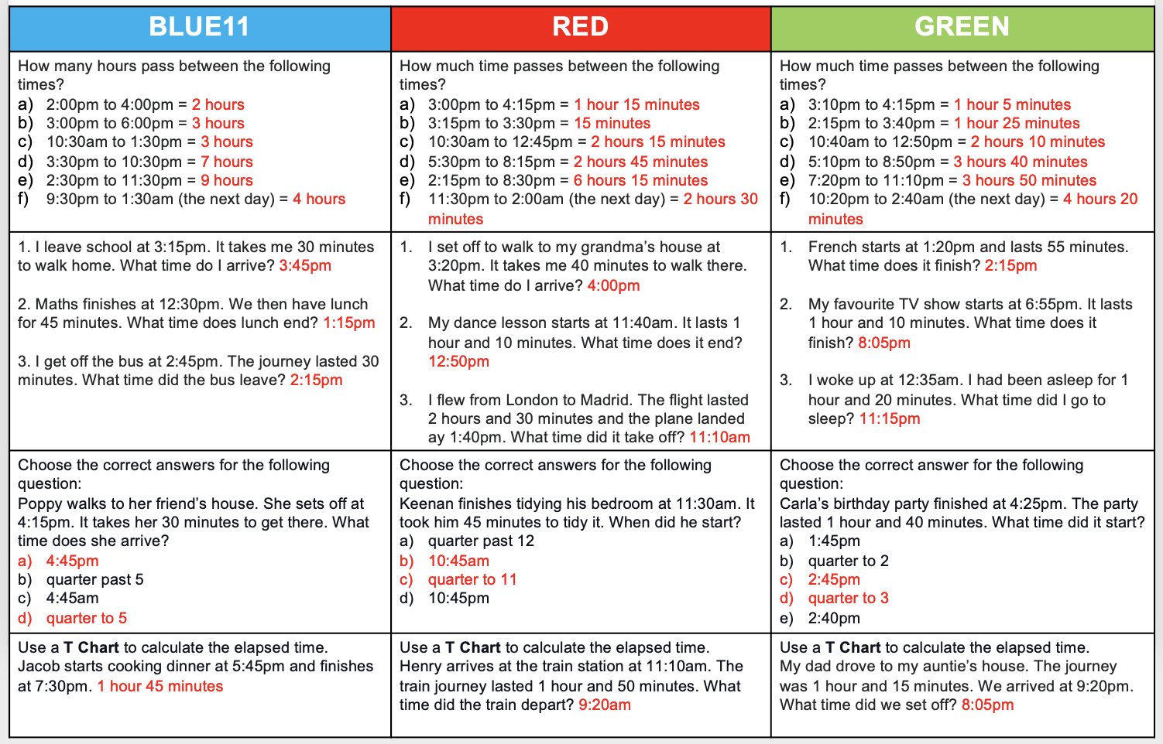
Wednesday

Slide 5
Thursday

Slide 6
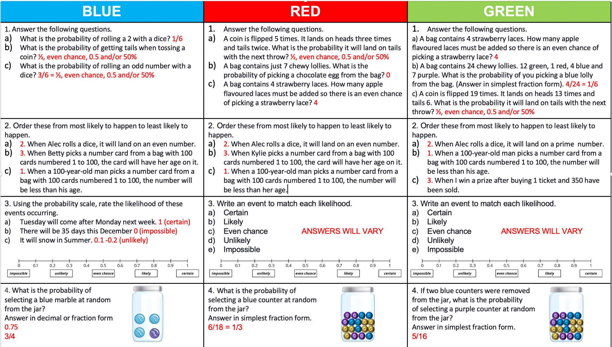
Friday

